Slide 1
WELCOME CAA
SWIM & DIVE COACHES
January 14, 2026

Slide 2
Introductions
Omni Otters Swim Club
Lindsey Harrigan
Dave Hulit
Catholic Athletic Association
Megan Jacobson, Director of Operations
CAA Coaches

Slide 3
CAA Vision and Mission​
Vision: The Catholic Athletic Association (CAA) creates an inclusive, welcoming and respectful atmosphere for its participants embracing acceptance of varied abilities and diversity through athletic competition.​
Mission: The Catholic Athletic Association (CAA) is a non-profit organization providing opportunities for young people attending member schools. The CAA develops and administers programs that encourage the religious, social and athletic development of its participants.​
Core Values:​
To promote participation in athletic activities​
To advance participants’ skills​
To create camaraderie and friendship​
To promote sportsmanship and teamwork​
To encourage social interaction and leadership​
CAA Sportsmanship Pledge​

Slide 4
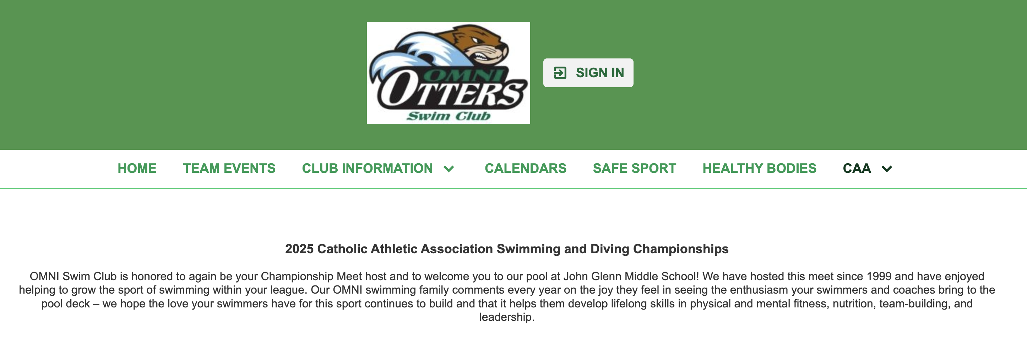
Communication
Email Communication
– Distribution list contact information
CAA Website
https://stpaulcaa.org/swimming
Omni Otter Website – public page and coach page
https://www.omniotters.com/page/caa

Slide 5
Championship Dates
Swim Prelims
Saturday, April 11 and Sunday, April 12, 2026
NEW LOCATION: The Michel Aquatic Center Saint Thomas Academy
Dive Prelims
No Dive prelim event planned for 2026
All divers advance to finals
Swim and Dive Finals
Tuesday, April 14, 2026 (Boys)
Wednesday, April 15, 2026 (Girls)
University of Minnesota Aquatic Center

Slide 6
CAA Rosters & Eligibility
Rosters
Athletic Director School Registration
CAA Roster are due Friday, April 3
ALL participants must have completed CAA player waiver form
Meet Entry File
* Posted on the Omni Swim website by Friday, Jan. 17
Eligible Swimmers
Participants must attend a participating CAA school
Grades K-8
Co-op teams allowed
Swimmers who compete on a high school team are permitted to participate

Slide 7
Discussion Topics
Clarification on Events
Swimmers may enter a maximum of 3 events. No more than 2 can be individual events. (0 individual events+3 relays, 1 individual+2 relays, 2 individual+1 relay). Diving is the only exception to this as it is considered to be it's own separate meet.
Consideration for Prelim Meet Format
Possibility of allowing swimmers who cannot attend Prelims—due to illness, scheduling conflicts, or multi-sport commitments—to still compete in the CAA Final State Meet if their event has fewer than 16 total swimmers.

Slide 8
Awards
Championship T-Shirts for Event Winners by age division and team division champions
More smaller sizes ordered this year!
No changes to the swim ribbons 1st-16th
Adding Dive specific ribbons
Patch for record holders

Slide 9


Slide 10
Questions?

